Slide 1
SECURE DATA HIDING IN IMAGE USING STEGANOGRAPHY
CAPSTONE PROJECT
Presented By: Narsing Joshna
Student Name : Narsing Joshna
College Name & Department : Rayalaseema University College of Engineering & Electronics and Communication Engineering

Slide 2
OUTLINE
Problem Statement
Technology used
Wow factor
End users
Result
Conclusion
Git-hub Link

Slide 3
Problem Statement
Image Steganography in Python
Overview
This project demonstrates an image Steganography tool implemented in Python,which allows users to embed secret messages within images for secure communication.The application provides a Graphical User Interface(GUI) that lets users easily encrypt and decrypt hidden messages within image files using a passcode for added security.This project is an excellent example of how Python can be used for image manipulation and data security.
Features :
Encrypt and Decrypt Messages : Hide and Retrieve secret messages inside images.
GUI Interface : Simple and user friendly interface built with python.
Passcode Protection : Secure encryption and decryption using a passcode.
Cross-Platform Support : Runs on python 3.7+,Windows,macOS,Linux.
Image File Support : Works with standard Image formats like JPG.
Real-Time Status Updates : Displays Status messages during the encryption and decryption process.

Slide 4
Technology used
Programming Language : Python
Libraries/ Frameworks:
OpenCV library (for manipulating Images,and Videos,Object detection)
Openstego (for data hiding and watermarking)
Stegano (for write a secret message by the sender and transfer it to the receiver)
Python ImageIO (for reading and write a wide range of image data)
Python File Handling (for file operations)

Slide 5
Wow factors
Advanced Steganography
Multi-Format Support
High Payload Capacity
Security Enhancements
Real-World Applications
Robust Anti-Detection Mechanisms
User friendly Features
Multi-Mode Data Extraction
AI & Machine Learning Integration
Trap Mechanism
Portable and Embedded System Support

Slide 6
End users
Cybersecurity Professionals & Ethical Hackers
Government & Military Agencies
Journalists & Whistleblowers
Corporate & Business Organizations
Researchers & Academicians
Digital Forensics & Law Enforcement
Artists and Content Creators
General Public and Privacy Enthusiasts

Slide 7
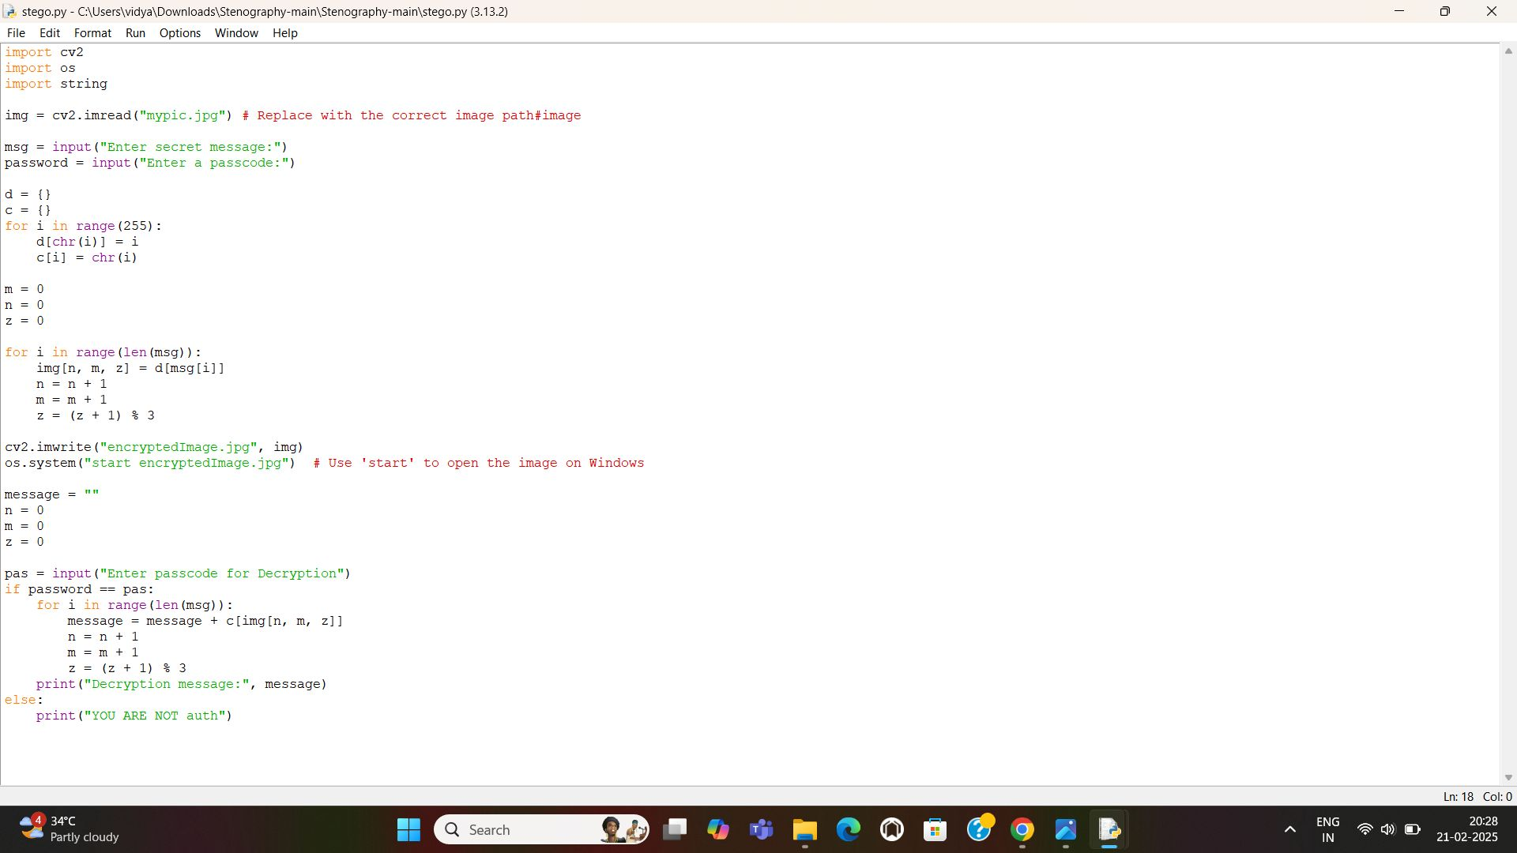
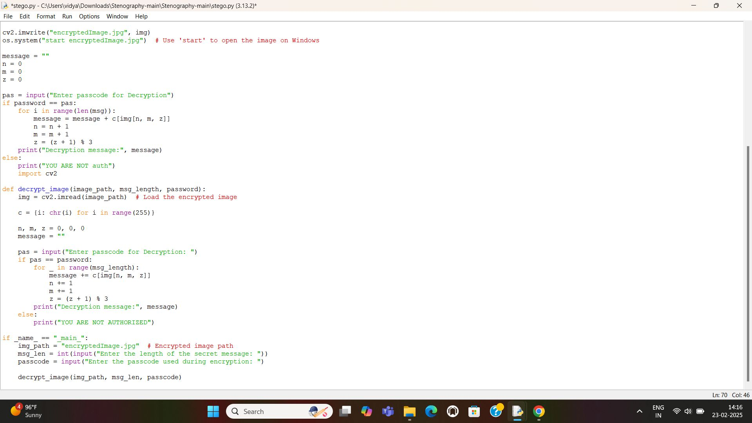
RESULT
ENCRYPTION
DECRYPTION

Slide 8
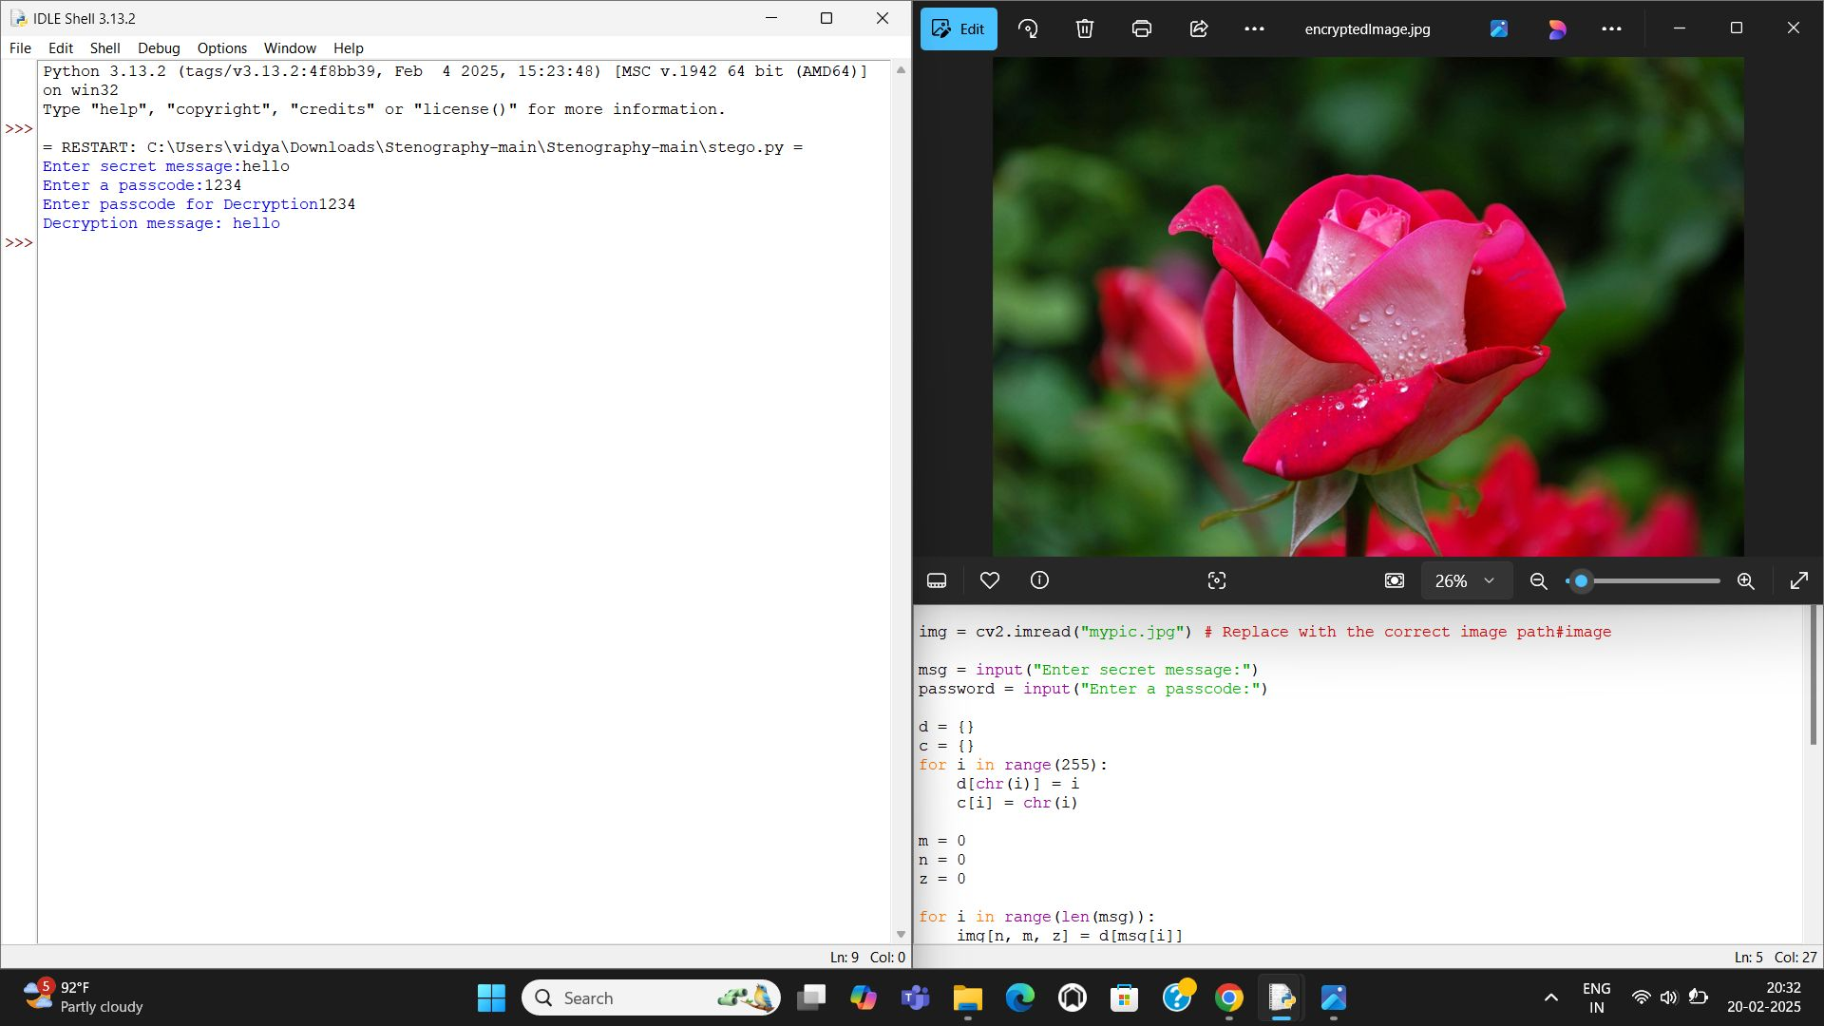
Result

Slide 9
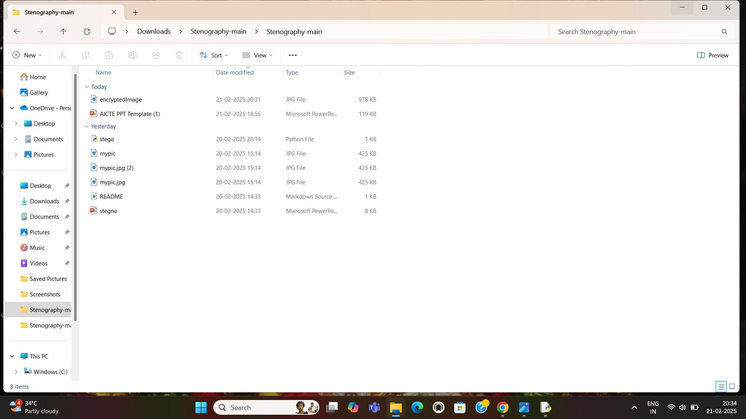
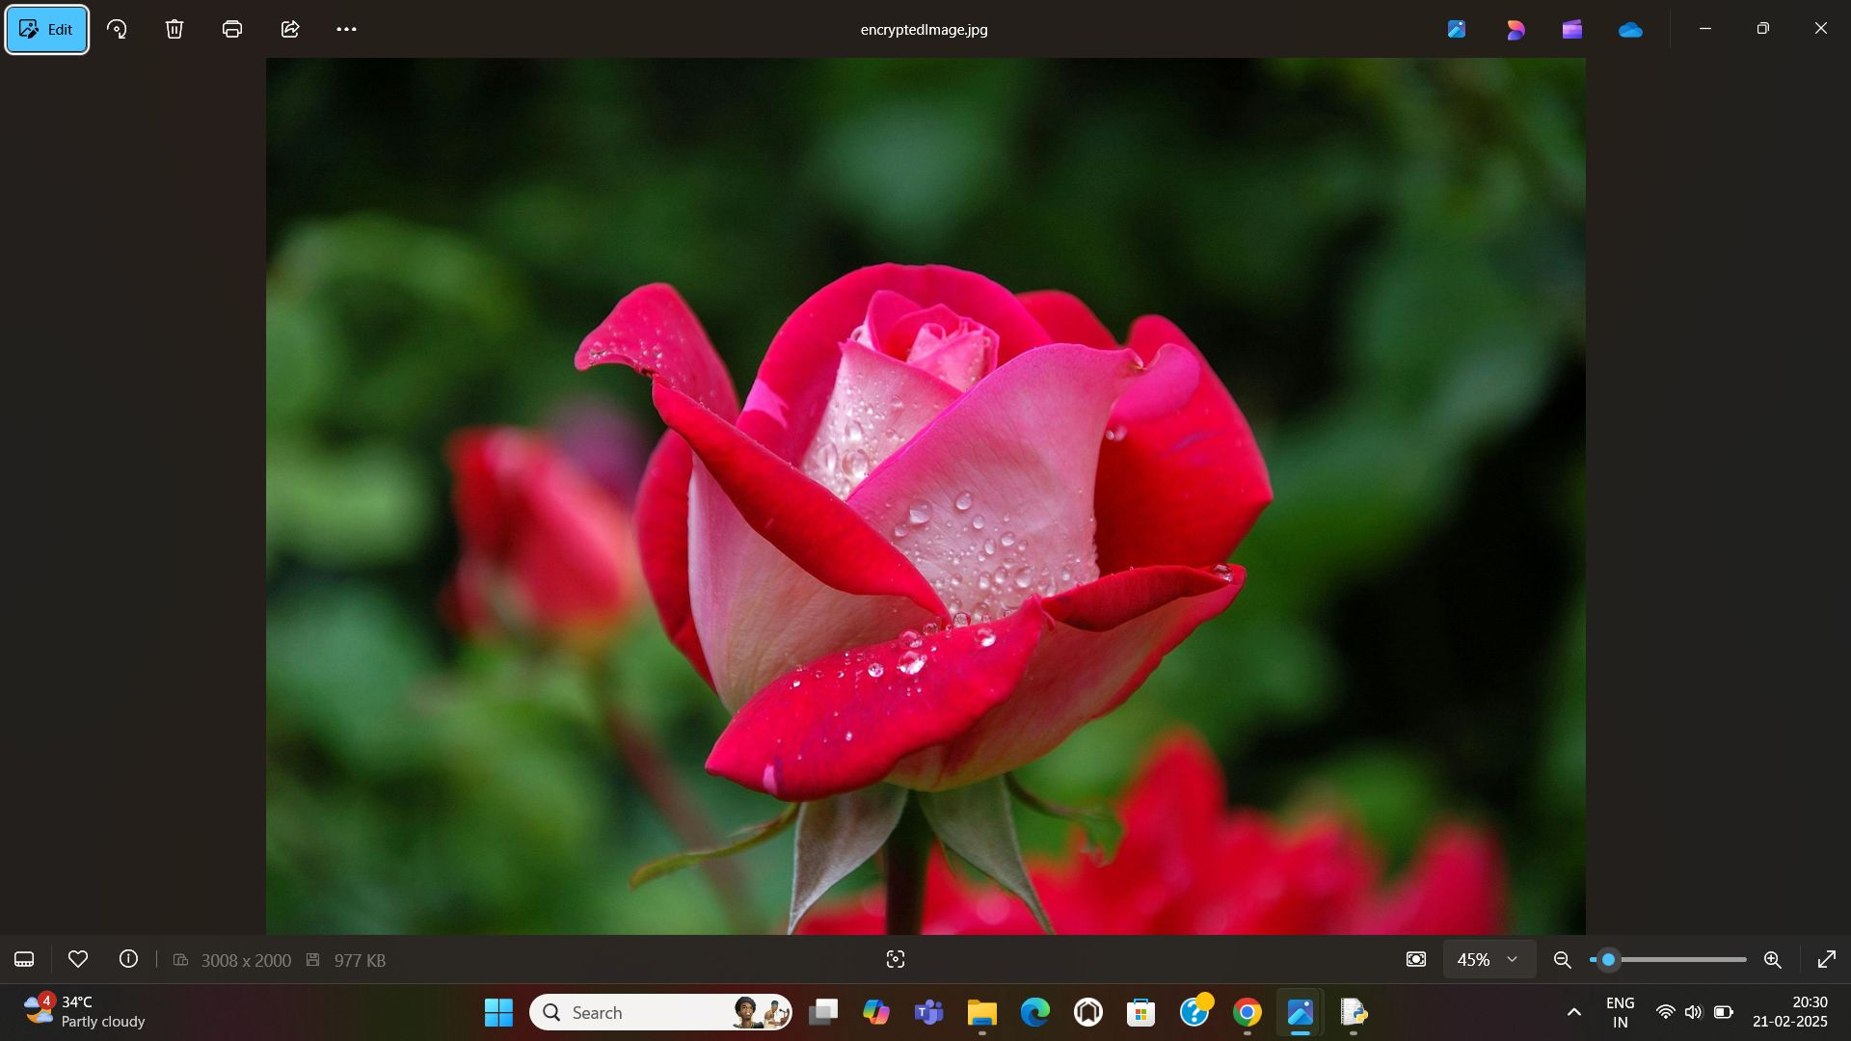
Result

Slide 10
Conclusion
Steganography is a powerfull technique for hiding information within digital media,ensuring secure communication and data protection.
Through this project we explored various steganographic methods,including image,audio,and text based techiques.
Steganography remains a valuable tool for secure information exchange,particularly when combined with encryption for enhanced security.

Slide 11
GITHUB LINK
https://github.com/Joshna2401/project-aicte.git

Slide 12
THANK YOU

